Slide 1

My Linear Relationships Interactive Notebook
Name
Class
Term 3 Semester 2

Slide 2
Contents
Formula Page
Page
Date
Description
2
3

Slide 3
Tasks
24
7
30
Essential Question
Questions
Notes
Summary
8
9

Slide 4
24
7
30
Date
Finding the length of a line
EQ – How is Pythagoras’ theorem used to find the length of a line between two points located on a Cartesian plane?
9

Slide 5
Geogebra
Two

Slide 6
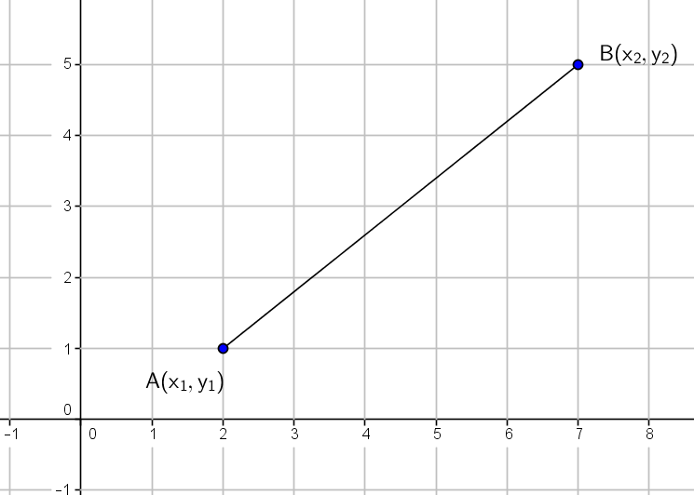
24
7
30
Date
Finding the length of a line
EQ – How is Pythagoras’ theorem used to find the length of a line between two points located on a Cartesian plane?
9

Slide 7
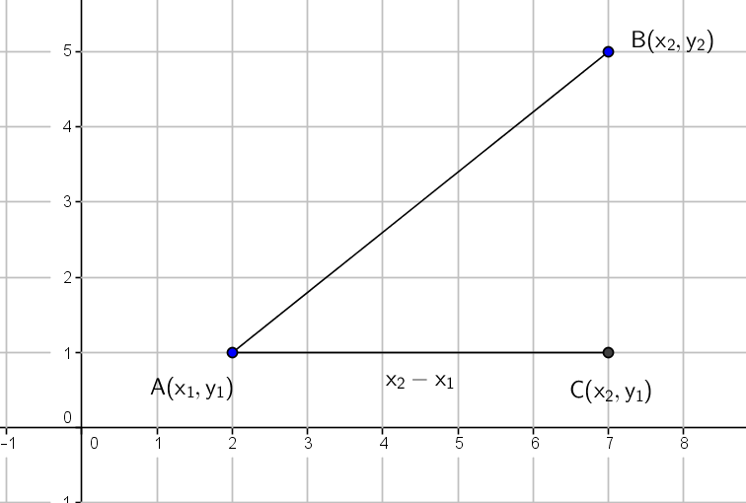
24
7
30
Date
Finding the length of a line
EQ – How is Pythagoras’ theorem used to find the length of a line between two points located on a Cartesian plane?
9

Slide 8
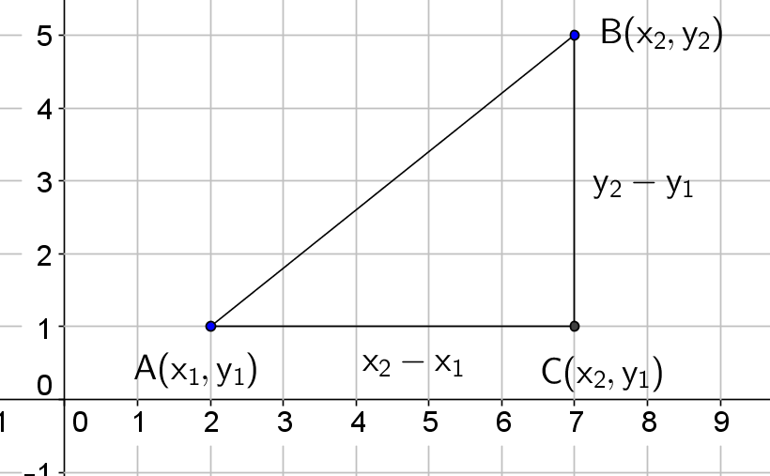
24
7
30
Date
Finding the length of a line
EQ – How is Pythagoras’ theorem used to find the length of a line between two points located on a Cartesian plane?
9

Slide 9
24
7
30
Date
Finding the length of a line
EQ – How is Pythagoras’ theorem used to find the length of a line between two points located on a Cartesian plane?
9

Slide 10
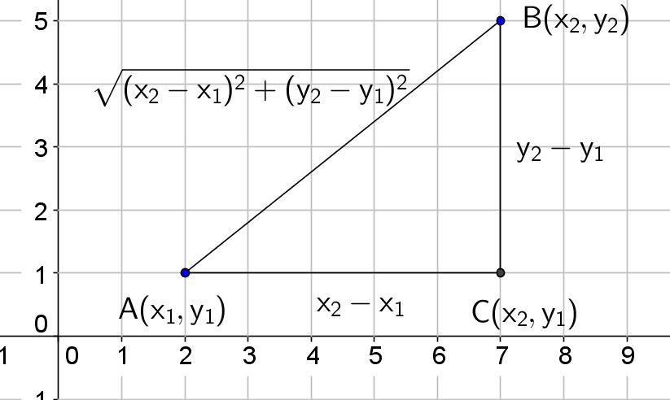
24
7
30
Date
Finding the length of a line
EQ – How is Pythagoras’ theorem used to find the length of a line between two points located on a Cartesian plane?
9

Slide 11
24
7
30
Date
Finding the length of a line
EQ – How is Pythagoras’ theorem used to find the length of a line between two points located on a Cartesian plane?
$$Length of line= \sqrt{({x_{2}−x_{1})}^{2}+{(y_{2}−y_{1})}^{2}}$$
9

Slide 12
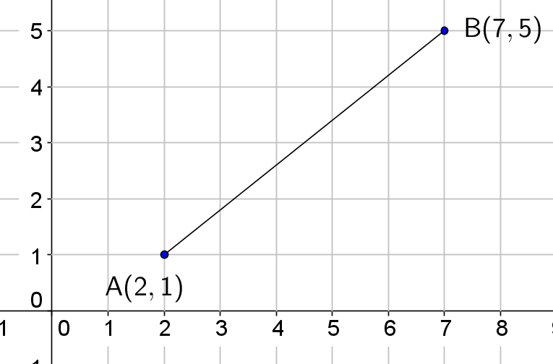
24
7
30
Date
Finding the length of a line
EQ – How is Pythagoras’ theorem used to find the length of a line between two points located on a Cartesian plane?
$$Length of line= \sqrt{({x_{2}−x_{1})}^{2}+{(y_{2}−y_{1})}^{2}}$$
Find the length of the line
9

Slide 13
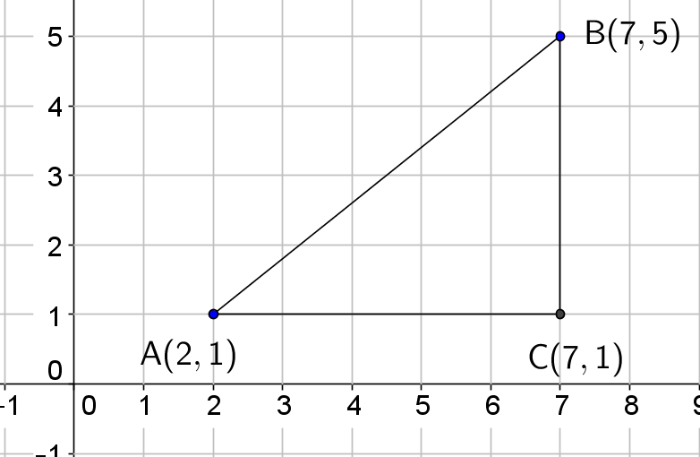
24
7
30
Date
Finding the length of a line
EQ – How is Pythagoras’ theorem used to find the length of a line between two points located on a Cartesian plane?
$$Length of line= \sqrt{({x_{2}−x_{1})}^{2}+{(y_{2}−y_{1})}^{2}}$$
Find the length of the line
9

Slide 14

24
7
30
Date
Finding the length of a line
EQ – How is Pythagoras’ theorem used to find the length of a line between two points located on a Cartesian plane?
$$Length of line= \sqrt{({x_{2}−x_{1})}^{2}+{(y_{2}−y_{1})}^{2}}$$
Find the length of the line
9

Slide 15
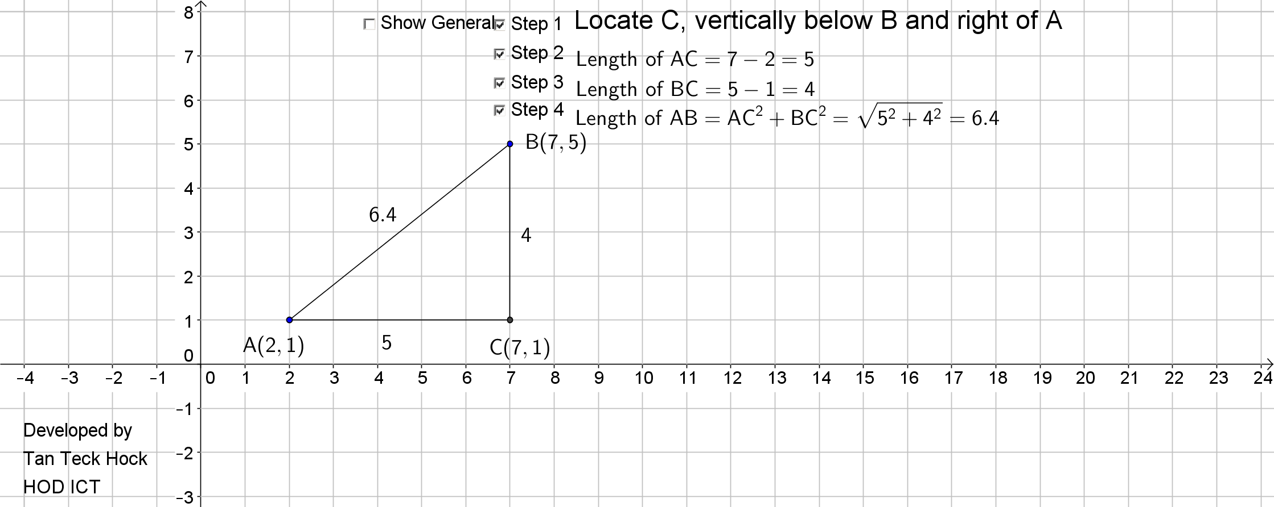
24
7
30
Date
Finding the length of a line
EQ – How is Pythagoras’ theorem used to find the length of a line between two points located on a Cartesian plane?
$$Length of line= \sqrt{({x_{2}−x_{1})}^{2}+{(y_{2}−y_{1})}^{2}}$$
Find the length of the line
9

Slide 16
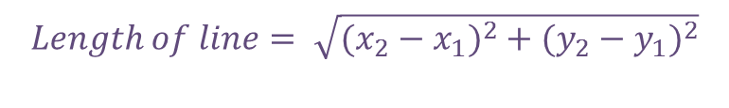
24
7
30
Date
Finding the length of a line
EQ – How is Pythagoras’ theorem used to find the length of a line between two points located on a Cartesian plane?
Find the length of the line
$$Length of line= \sqrt{({x_{2}−x_{1})}^{2}+{(y_{2}−y_{1})}^{2}}$$
9

Slide 17
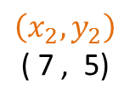
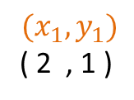
24
7
30
Date
Finding the length of a line
EQ – How is Pythagoras’ theorem used to find the length of a line between two points located on a Cartesian plane?
Find the length of the line
$$\left(x_{2},y_{2}\right)$$
( 7 , 5)
$$(x_{1},y_{1})$$
( 2 , 1 )
$$Length of line= \sqrt{({x_{2}−x_{1})}^{2}+{(y_{2}−y_{1})}^{2}}$$
9

Slide 18
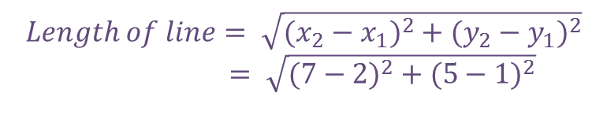
24
7
30
Date
Finding the length of a line
EQ – How is Pythagoras’ theorem used to find the length of a line between two points located on a Cartesian plane?
Find the length of the line
$$\left(x_{2},y_{2}\right)$$
( 7 , 5)
$$(x_{1},y_{1})$$
( 2 , 1 )
$$Length of line= \sqrt{({x_{2}−x_{1})}^{2}+{(y_{2}−y_{1})}^{2}}$$
$= \sqrt{({7−2)}^{2}+{(5−1)}^{2}}$
9

Slide 19
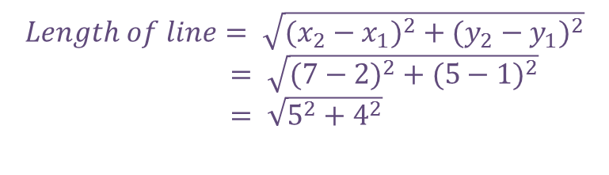
24
7
30
Date
Finding the length of a line
EQ – How is Pythagoras’ theorem used to find the length of a line between two points located on a Cartesian plane?
Find the length of the line
$$\left(x_{2},y_{2}\right)$$
( 7 , 5)
$$(x_{1},y_{1})$$
( 2 , 1 )
$$Length of line= \sqrt{({x_{2}−x_{1})}^{2}+{(y_{2}−y_{1})}^{2}}$$
$= \sqrt{({7−2)}^{2}+{(5−1)}^{2}}$
$= \sqrt{5^{2}+4^{2}}$
9

Slide 20
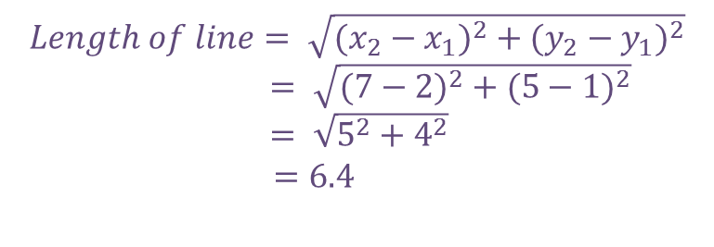
24
7
30
Date
Finding the length of a line
EQ – How is Pythagoras’ theorem used to find the length of a line between two points located on a Cartesian plane?
Find the length of the line
$$\left(x_{2},y_{2}\right)$$
( 7 , 5)
$$(x_{1},y_{1})$$
( 2 , 1 )
$$Length of line= \sqrt{({x_{2}−x_{1})}^{2}+{(y_{2}−y_{1})}^{2}}$$
$= \sqrt{({7−2)}^{2}+{(5−1)}^{2}}$
$= \sqrt{5^{2}+4^{2}}$
$=6.4$
9

Slide 21
24
7
30
Date
Finding the length of a line
EQ – How is Pythagoras’ theorem used to find the length of a line between two points located on a Cartesian plane?
Find the length of the line
$$\left(x_{2},y_{2}\right)$$
( 7 , 5)
$$(x_{1},y_{1})$$
( 2 , 1 )
$$Length of line= \sqrt{({x_{2}−x_{1})}^{2}+{(y_{2}−y_{1})}^{2}}$$
$= \sqrt{({7−2)}^{2}+{(5−1)}^{2}}$
$= \sqrt{5^{2}+4^{2}}$
$=6.4$
9

Slide 22
Questions

Slide 23
Notes Review
24, 7 ,30
Date
Title
Essential question
Notes complete
Notes complete with colour and diagrams
Questions completed
Contents page filed in
Formula page filled in

Slide 24
Homework
Review your notes and write a summary answering the essential question.

